Slide 1
An overview of IPD-MAs on Cochrane IPD-MA methods group library
Michail Belias
Department for Health Evidence

Slide 2
mini abstract
Individual participant data(IPD) meta-analysis(MA) is considered the gold standard to investigate treatment effect modification.
Multiple methods have been proposed involving both one-stage and two-stage approaches.
Literature over the advantages and disadvantages of these approaches is available.
But it is unclear to what level researchers have adopted this guidance
Our aim is to identify which approaches are applied in order to investigate effect modification in IPD-MAs.
“we aim to inform over the best practice”

Slide 3
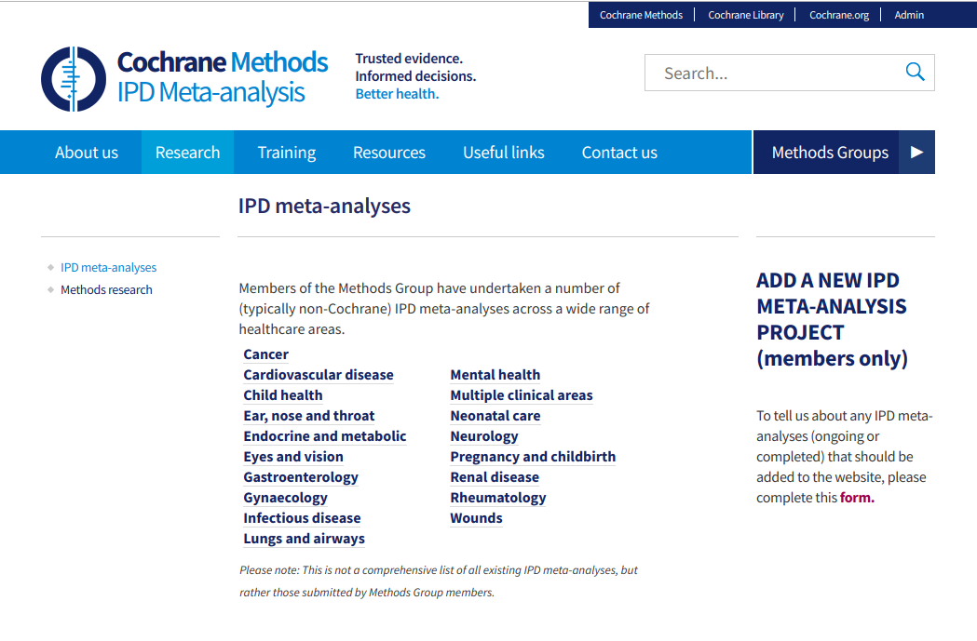

Slide 4
Cochrane IPD-MA methods group
202 IPD-MA were identified in the Cochrane IPD-MA methods group
18 medical fields
96 IPD-MAs were cancer related
34 Cardiovascular diseases
16 Neurology
10 pregnancy and child birth
Others had less than 10 IPD-MAs
Years of publication 1991-2018

Slide 5
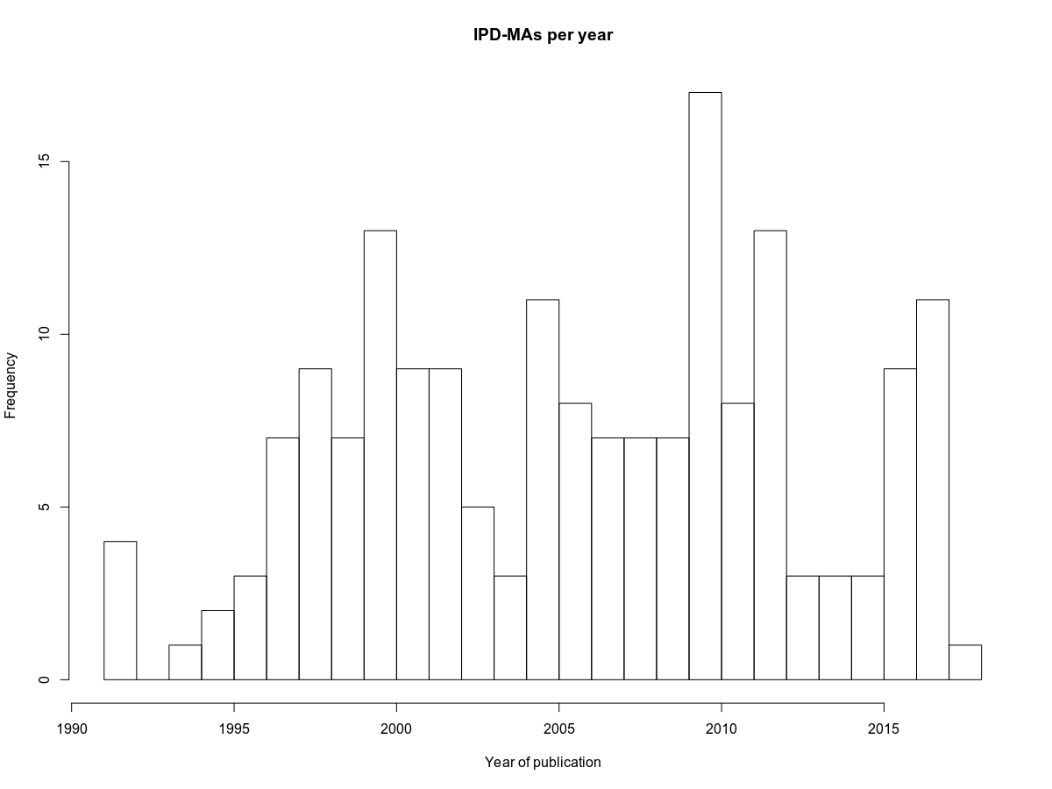

Slide 6
74 IPD-MAs were exluded
4 studies were not available
11 were ongoing and didn't provide data
26 were investigating risk factors
33 had different study designs than RCTs

Slide 7
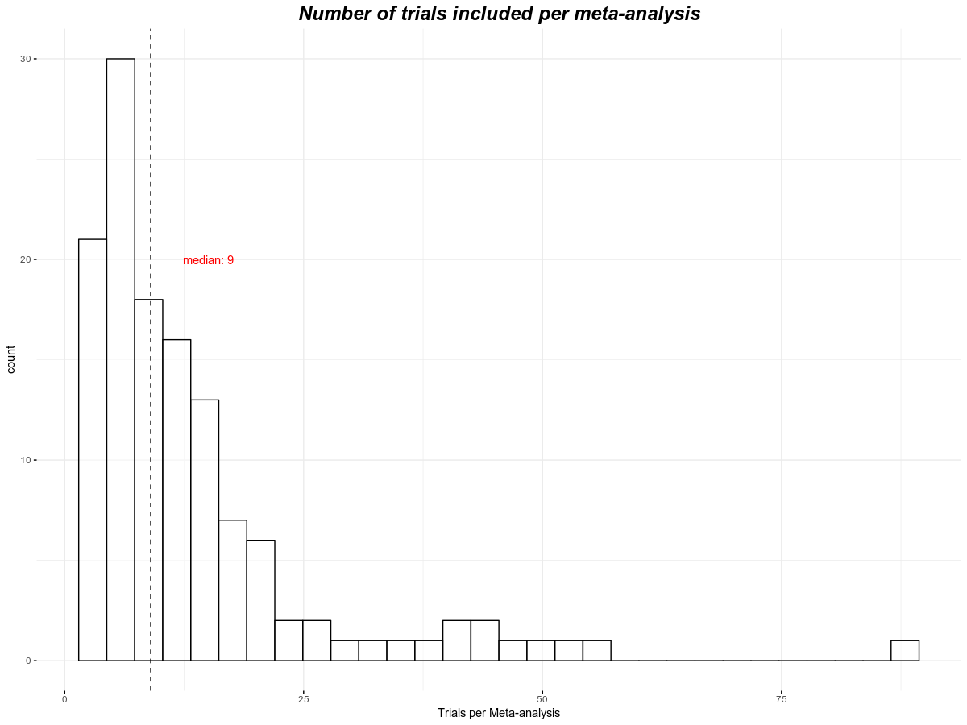

Slide 8
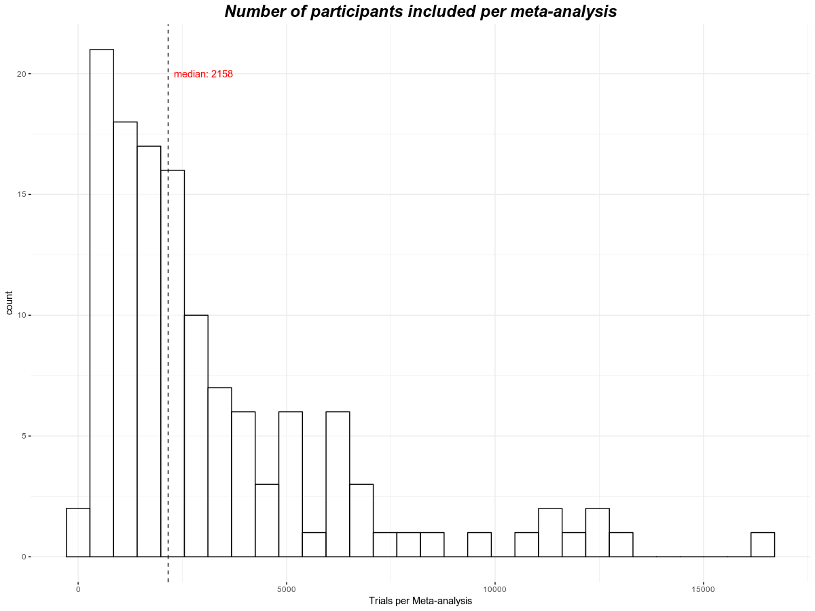

Slide 9
Some preliminary results
Terminology was not consistent
sometimes it was unlcear which method has been performed
Quality of IPD-MA is improving by year
Articles before 2010 used only PS-MA and fixed-effects pooled analyses
Per-subgroup meta-analysis is still typically performed
Interaction is often measured with cochran's Q (Χ² test of trend or interaction)
Almost all studies have categorised the continuous effect modifier
Rarely effect modification has been investigated with the continuous effect modifier as it is
Linearity has been assumed in all cases
One-stage methods are rarely performed
most use only a stratified intercept approach
Some are unclear of the approach they used
No per-trial centring of the effect modifier has been reported

Slide 10
What to add?
One of the limitations is that I have identified only IPD-MAs in the Cochrane IPD-MA methods group
We can also expand our search into every IPD-MA from a certain time point
For instance, 2011 as before that there was limited guidance
Untill now I am looking for:
Size of the meta-analysis
Type of studies included in the meta-analysis
Whether they investigated for effect modification
Over which variables and what type were they (Continuous, categorical)
Which method they used

Slide 11
Effect modification
Preliminary results
Effect modification is explored in most of the trials (~ 85%) , but only a few have them as a main goal and therefore
approximatelly 60% have performed per-subgroup meta-analysis
20% two-stage meta-analysis of interaction terms
Only 5% used a one-stage approach (mostly with a stratified intercept)

